Slide 1
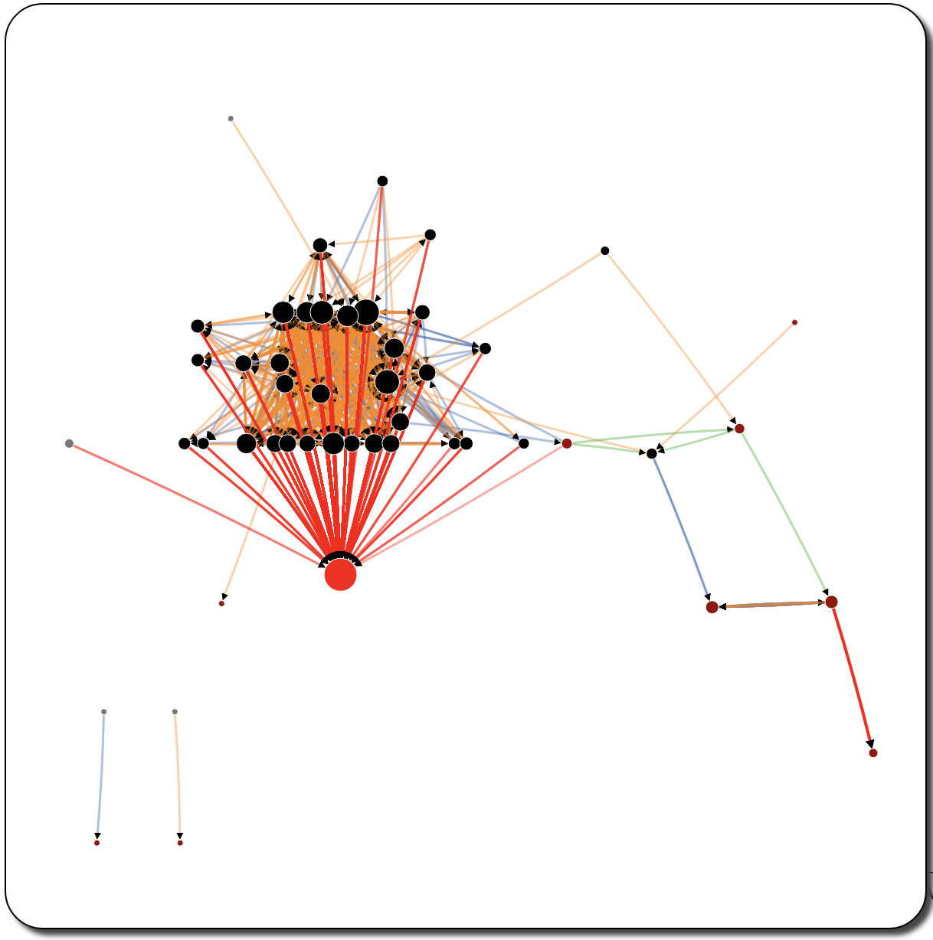
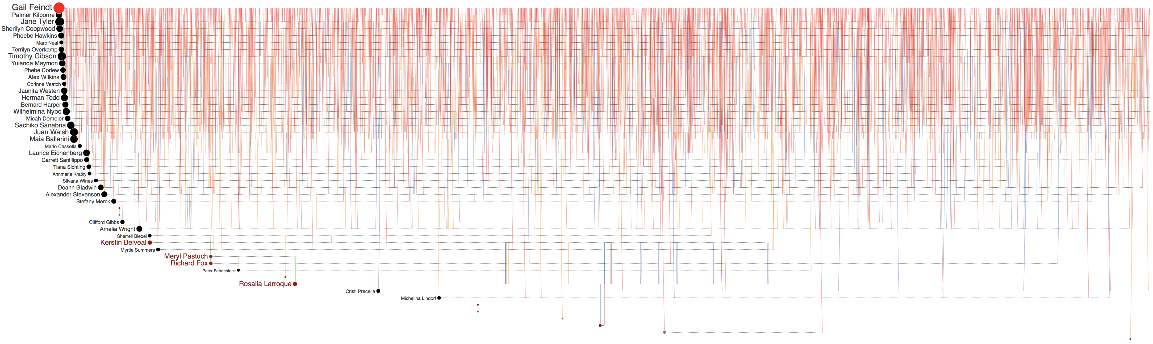
Peter Fahnestock
Meryl Pastuch
Richard Fox
Sherrell Biebel
Kerstin Belvea
Rosalia Larroque
Gail Feindt
Jenice Savaria
Jenice Savaria
(a)
(b)
Jenice Savaria

Slide 2
Peter Fahnestock
Meryl Pastuch
Richard Fox
Sherrell Biebel
Kerstin Belvea
Rosalia Larroque
Gail Feindt
Jenice Savaria
Jenice Savaria
(a)
(b)
Jenice Savaria

Slide 3
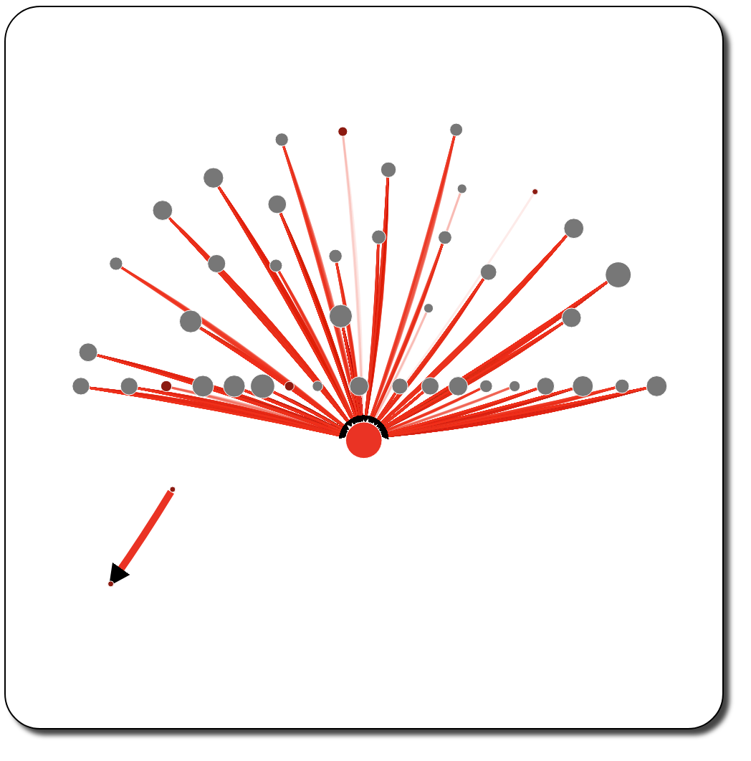
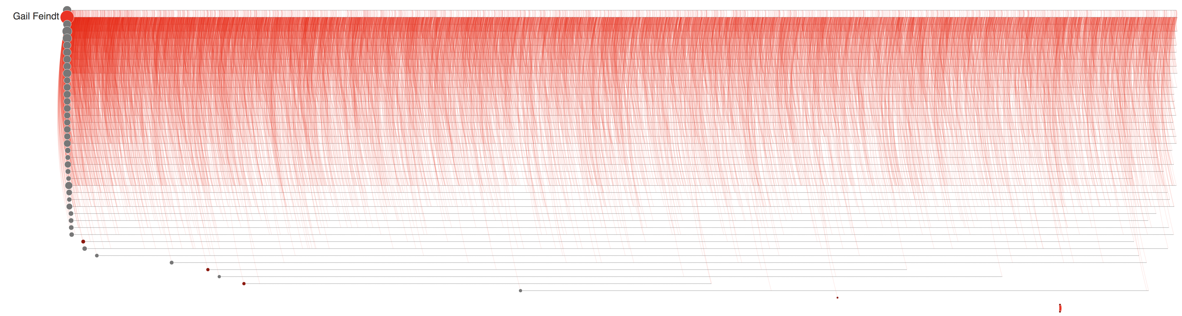


Rosalia Larroque
Jenice Savaria
(a)
(b)
Rosalia Larroque
Jenice Savaria

Slide 4
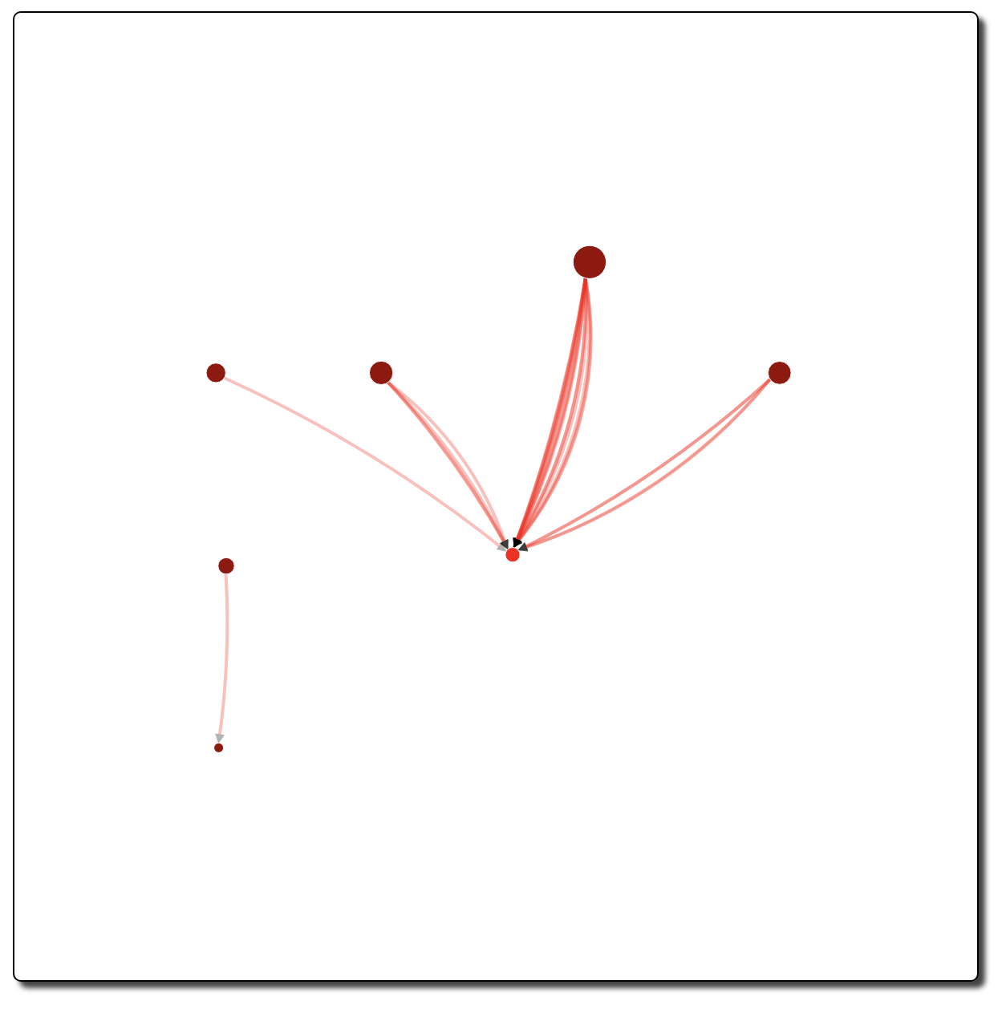
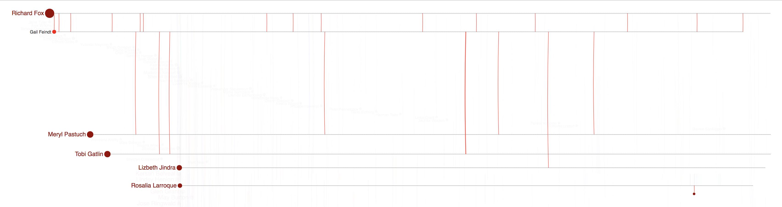
(a)
(b)

Slide 5
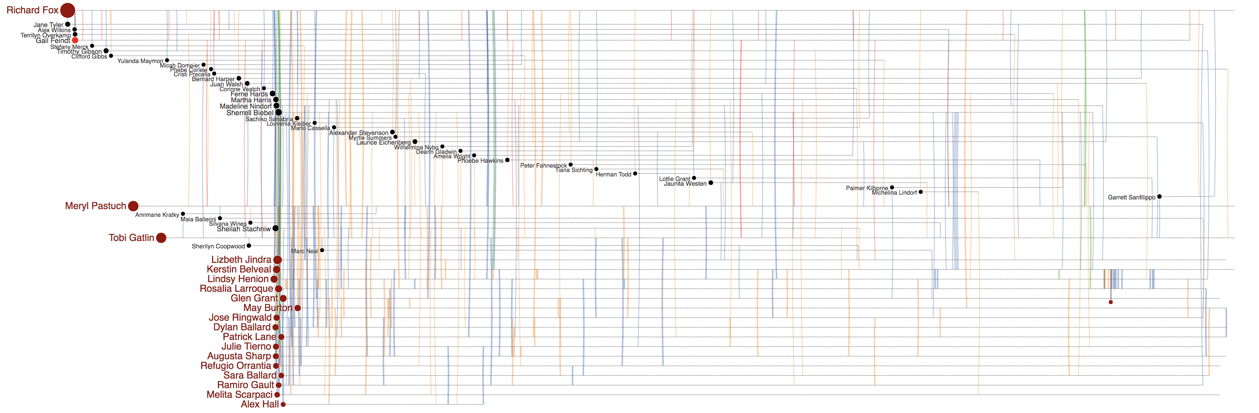
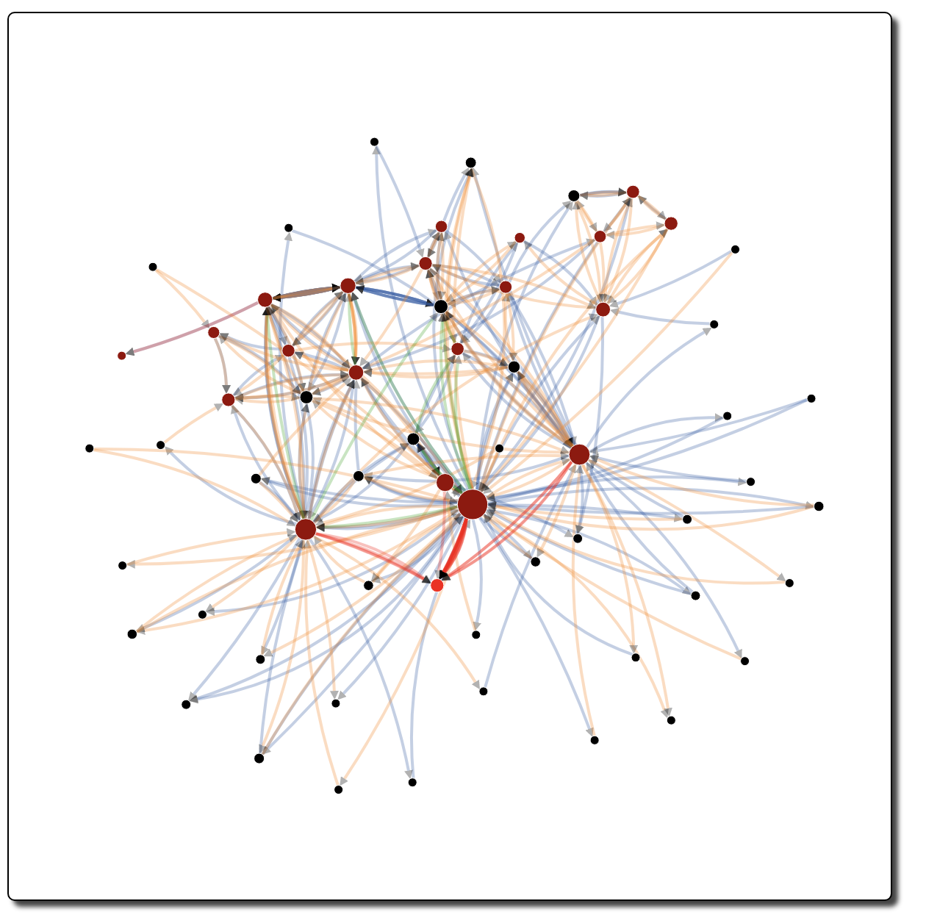
(a)
(b)

Slide 6
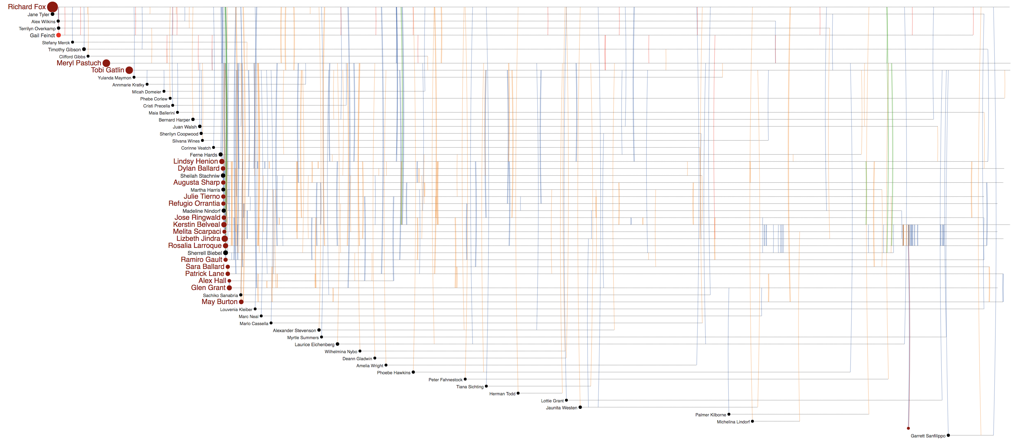
(a)
(b)

Slide 7
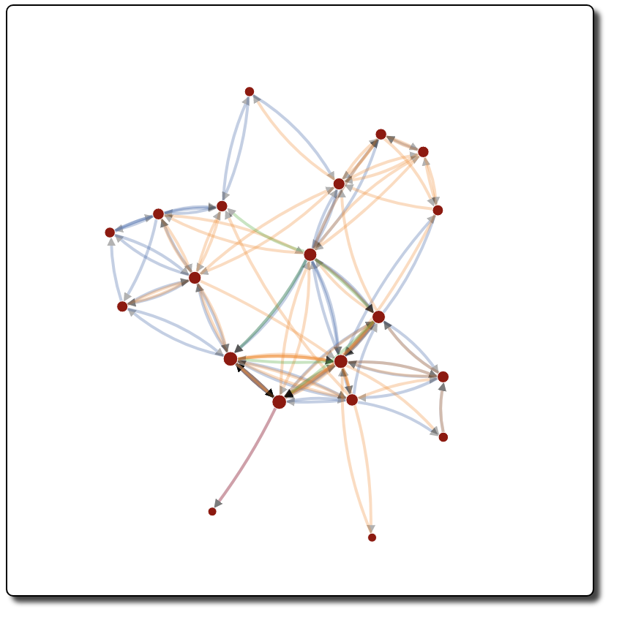
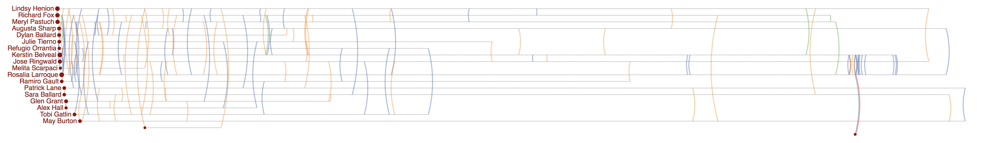
(b)
(a)

